Slide 1
Cell Communication
Chapter 11

Slide 2
Overview: Cellular Messaging
Cell-to-cell communication is essential for both multicellular and unicellular organisms
Biologists have discovered some universal mechanisms of cellular regulation
Cells most often communicate with each other via chemical signals
For example, the fight-or-flight response is triggered by a signaling molecule called epinephrine

Slide 3
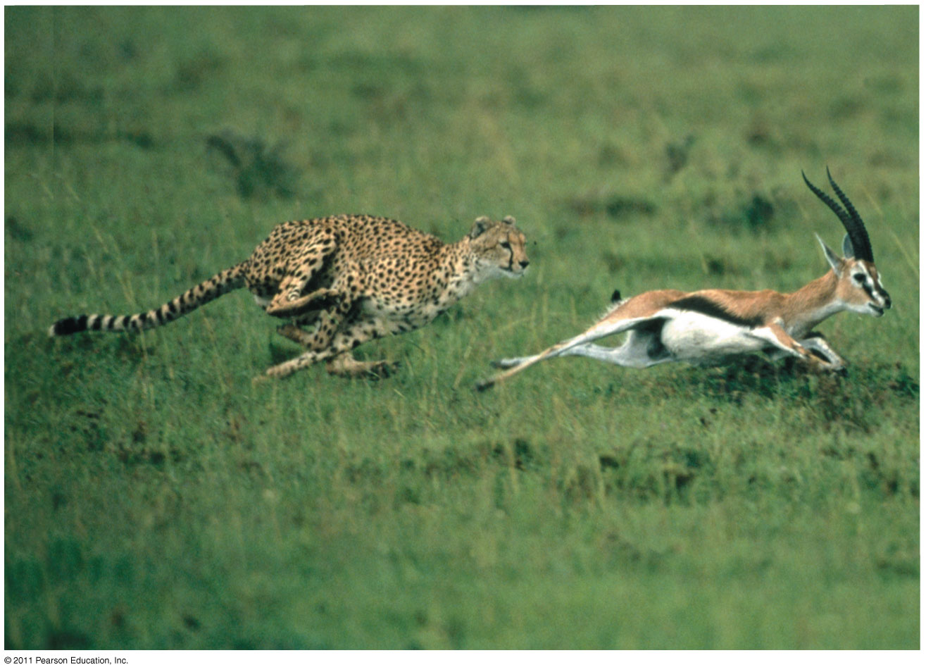
Cellular Messaging

Slide 4
External signals are converted to responses within the cell
Microbes provide a glimpse of the role of cell signaling in the evolution of life

Slide 5
Evolution of Cell Signaling
The yeast, Saccharomyces cerevisiae, has two mating types, a and α
Cells of different mating types locate each other via secreted factors specific to each type
A signal transduction pathway is a series of steps by which a signal on a cell’s surface is converted into a specific cellular response
Signal transduction pathways convert signals on a cell’s surface into cellular responses

Slide 6
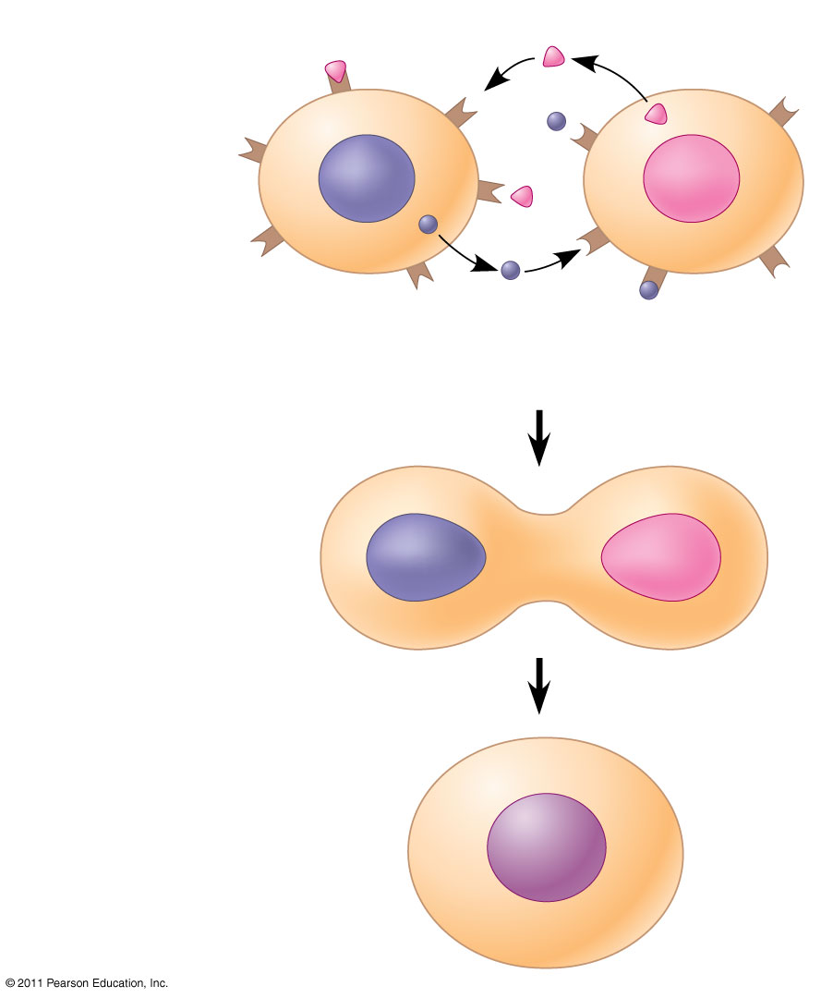
Communication between mating yeast cells
α factor
Receptor
Exchange
of mating
factors
a
α
Yeast cell,
mating type a
a factor
Yeast cell,
mating type α
Mating
New a/α cell

Slide 7
Cell Signaling
Pathway similarities suggest that ancestral signaling molecules evolved in prokaryotes and were modified later in eukaryotes
The concentration of signaling molecules allows bacteria to sense local population density

Slide 8
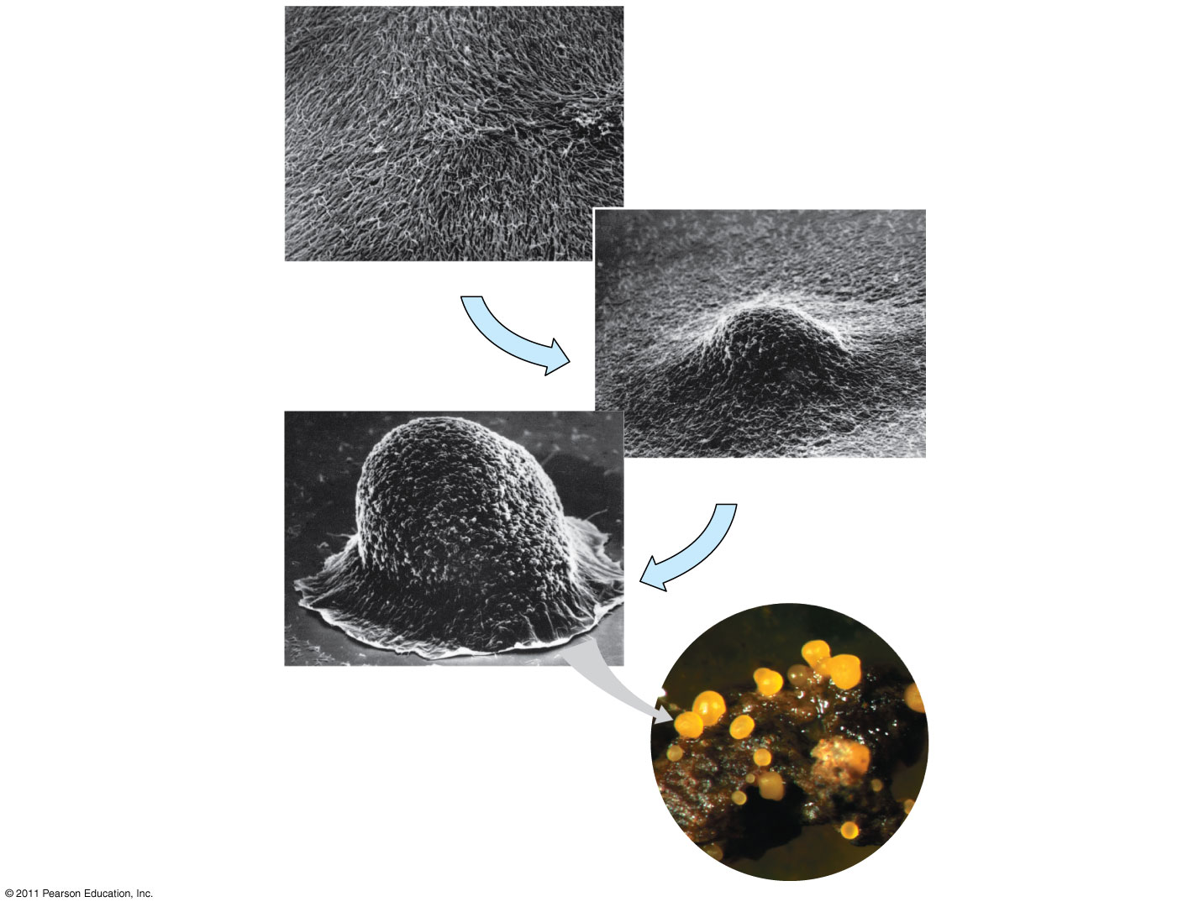
Communication among bacteria
Individual
rod-shaped
cells
Aggregation
in progress
Spore-forming
structure
(fruiting body)
Fruiting bodies

Slide 9
Local and Long-Distance Signaling
Cells in a multicellular organism communicate by chemical messengers
Animal and plant cells have cell junctions that directly connect the cytoplasm of adjacent cells
In local signaling, animal cells may communicate by direct contact, or cell-cell recognition

Slide 10
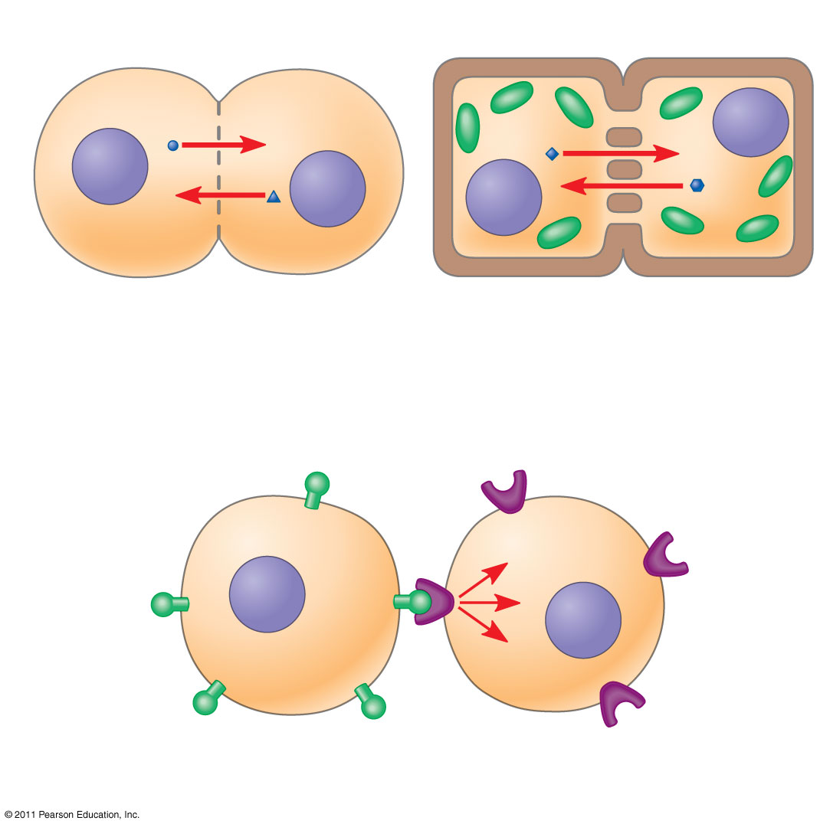
Communication by direct contact between cells
Plasma membranes
(a) Cell junctions
Gap junctions
between animal cells
Plasmodesmata
between plant cells
(b) Cell-cell recognition

Slide 11
Local and Long-Distance Signaling
In many other cases, animal cells communicate using local regulators, messenger molecules that travel only short distances
In long-distance signaling, plants and animals use chemicals called hormones
The ability of a cell to respond to a signal depends on whether or not it has a receptor specific to that signal

Slide 12
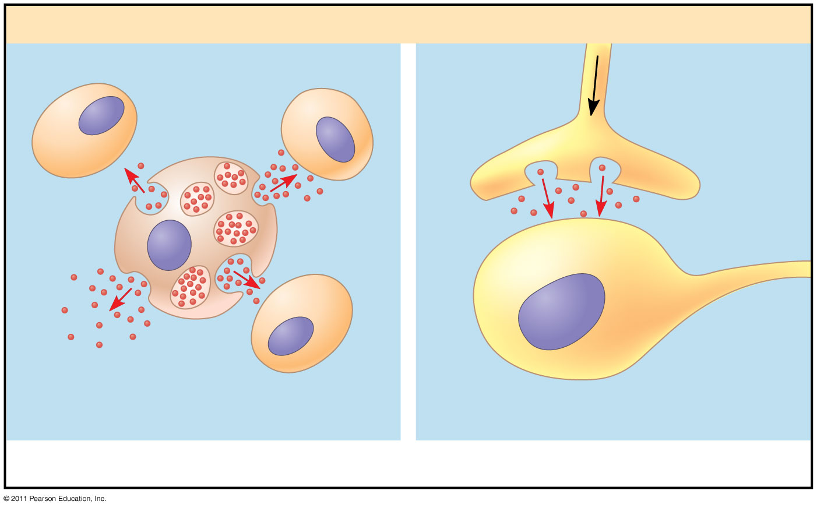
Local and long-distance cell signaling by secreted molecules in animals
Local signaling
Target cell
Electrical signal
along nerve cell
triggers release of
neurotransmitter.
Neurotransmitter
diffuses across
synapse.
Secreting
cell
Secretory
vesicle
Local regulator
diffuses through
extracellular fluid.
Target cell
is stimulated.
(a) Paracrine signaling
(b) Synaptic signaling

Slide 13
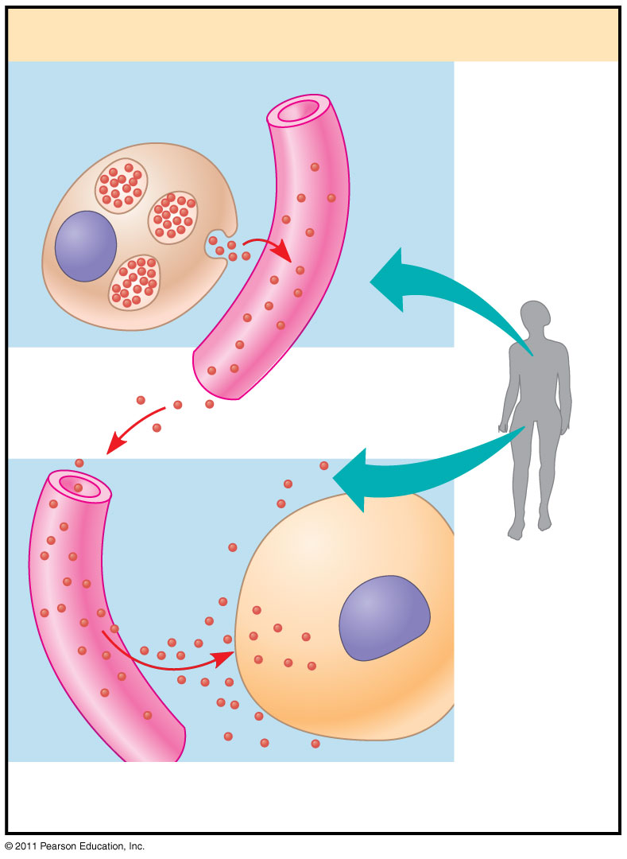
Local and long-distance cell signaling by secreted molecules in animals
Long-distance signaling
Endocrine cell
Blood
vessel
Hormone travels
in bloodstream.
Target cell
specifically
binds
hormone.
c) Endocrine (hormonal) signaling

Slide 14
The Three Stages of Cell Signaling:
A Preview
Earl W. Sutherland discovered how the hormone epinephrine acts on cells
Sutherland suggested that cells receiving signals went through three processes
  Reception
  Transduction
  Response

Slide 15
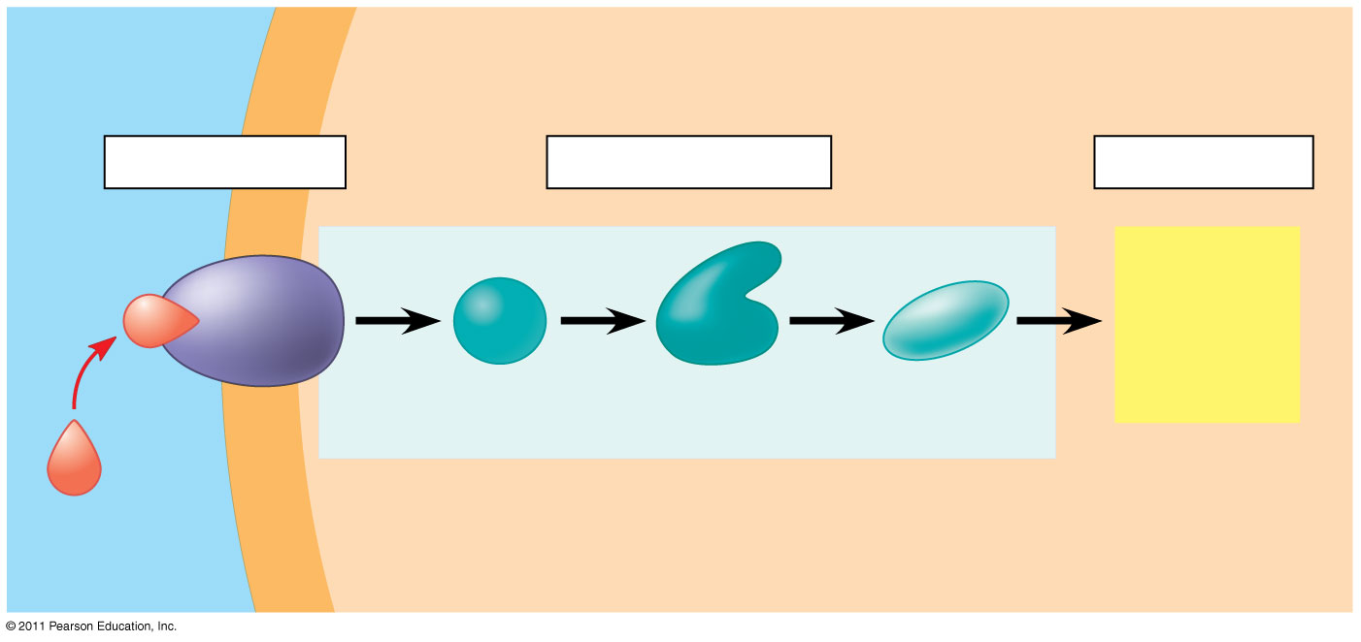
Overview of cell signaling
EXTRACELLULAR
FLUID
CYTOPLASM
Reception
Transduction
Response
Receptor
Activation
of cellular
response
Relay molecules in a signal transduction
pathway
Signaling
molecule

Slide 16
Reception: A signaling molecule binds to a receptor protein, causing it to change shape
The binding between a signal molecule (ligand) and receptor is highly specific
A shape change in a receptor is often the initial transduction of the signal
Most signal receptors are plasma membrane proteins

Slide 17
Receptors in the Plasma Membrane
Most water-soluble signal molecules bind to specific sites on receptor proteins that span the plasma membrane
There are three main types of membrane receptors:
  G protein-coupled receptors
  Receptor tyrosine kinases
  Ion channel receptors

Slide 18
Receptors in the Plasma Membrane
G protein-coupled receptors (GPCRs) are the largest family of cell-surface receptors
A GPCR is a plasma membrane receptor that works with the help of a G protein
The G protein acts as an on/off switch: If GDP is bound to the G protein, the G protein is inactive

Slide 19
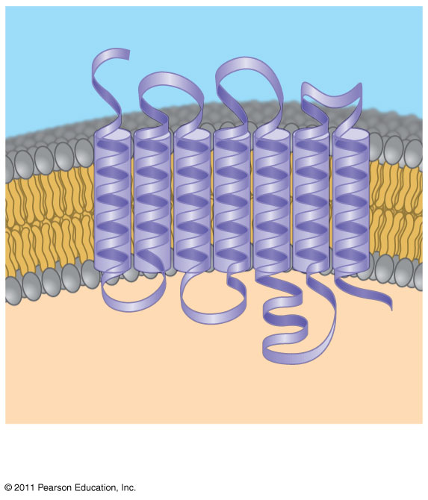
Exploring: Cell-Surface Transmembrane Receptors
Signaling molecule binding site
Segment that
interacts with
G proteins
G protein-coupled receptor

Slide 20
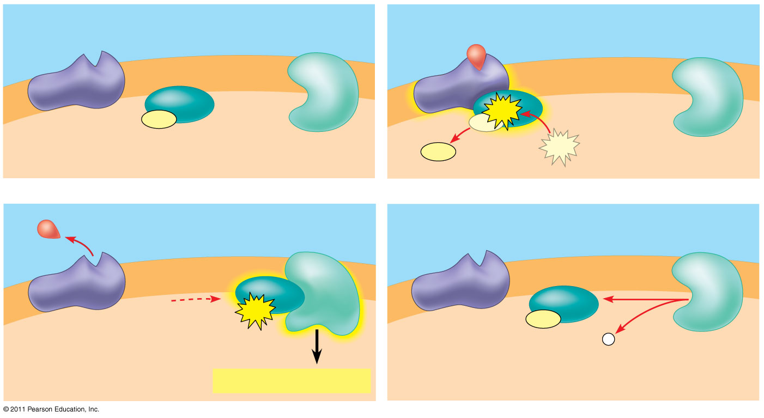
Exploring: Cell-Surface Transmembrane Receptors
G protein-coupled
receptor
Plasma
membrane
Activated
receptor
Signaling
molecule
Inactive
enzyme
GDP
GTP
G protein
(inactive)
Enzyme
GTP
CYTOPLASM
GDP
Activated
enzyme
GTP
GDP
P _{i}
Cellular response

Slide 21
Exploring: Cell-Surface Transmembrane Receptors
Receptor tyrosine kinases (RTKs) are membrane receptors that attach phosphates to tyrosines
A receptor tyrosine kinase can trigger multiple signal transduction pathways at once
Abnormal functioning of RTKs is associated with many types of cancers

Slide 22
Exploring: Cell-Surface Transmembrane Receptors
A ligand-gated ion channel receptor acts as a gate when the receptor changes shape
When a signal molecule binds as a ligand to the receptor, the gate allows specific ions, such as Na⁺ or Ca²⁺, through a channel in the receptor

Slide 23
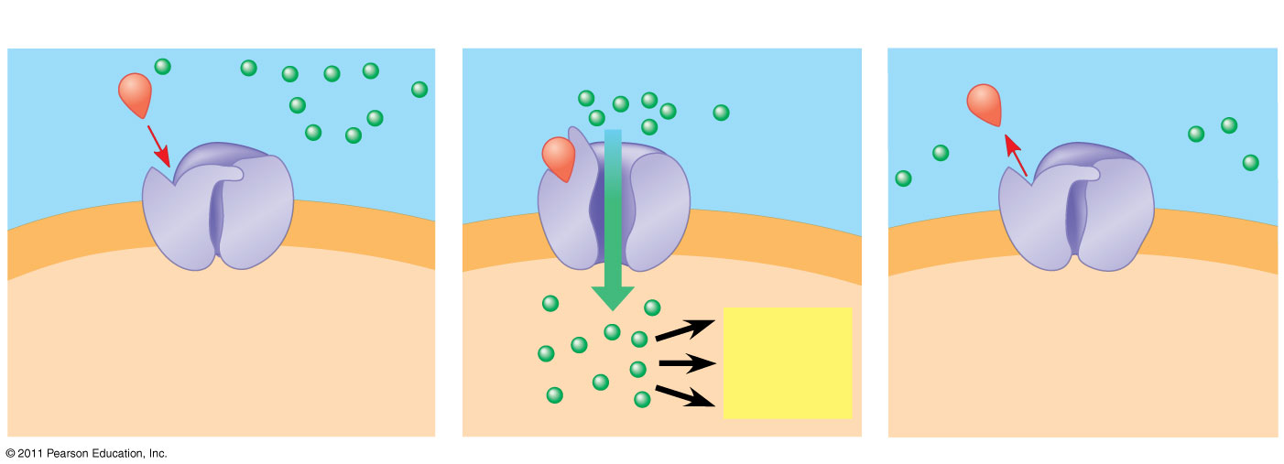
Exploring: Cell-Surface Transmembrane Receptors
Gate
open
Signaling
molecule
(ligand)
Ions
Gate
closed
Gate closed
Ligand-gated
ion channel receptor
Plasma
membrane
Cellular
response

Slide 24
Intracellular Receptors
Intracellular receptor proteins are found in the cytosol or nucleus of target cells
Small or hydrophobic chemical messengers can readily cross the membrane and activate receptors
Examples of hydrophobic messengers are the steroid and thyroid hormones of animals
An activated hormone-receptor complex can act as a transcription factor, turning on specific genes

Slide 25
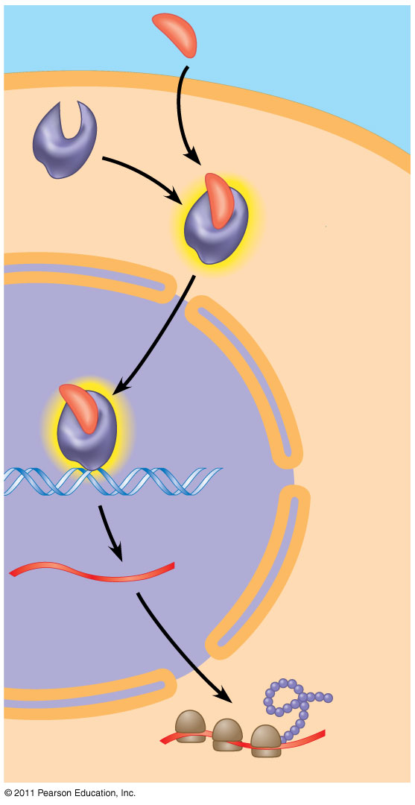
Steroid hormone interacting with an intracellular receptor
Hormone
(testosterone)
EXTRACELLULAR
FLUID
Plasma
membrane
Receptor
protein
Hormone-
receptor
complex
DNA
mRNA
NUCLEUS
New protein
CYTOPLASM

Slide 26
Transduction: Cascades of molecular interactions relay signals from receptors to target molecules in the cell
Signal transduction usually involves multiple steps
Multistep pathways can amplify a signal: A few molecules can produce a large cellular response
Multistep pathways provide more opportunities for coordination and regulation of the cellular response

Slide 27
Signal Transduction Pathways
The molecules that relay a signal from receptor to response are mostly proteins
Like falling dominoes, the receptor activates another protein, which activates another, and so on, until the protein producing the response is activated
At each step, the signal is transduced into a different form, usually a shape change in a protein

Slide 28
Protein Phosphorylation and Dephosphorylation
In many pathways, the signal is transmitted by a cascade of protein phosphorylations
Protein kinases transfer phosphates from ATP to protein, a process called phosphorylation

Slide 29
Protein Phosphorylation and Dephosphorylation
Protein phosphatases remove the phosphates from proteins, a process called dephosphorylation
This phosphorylation and dephosphorylation system acts as a molecular switch, turning activities on and off or up or down, as required

Slide 30
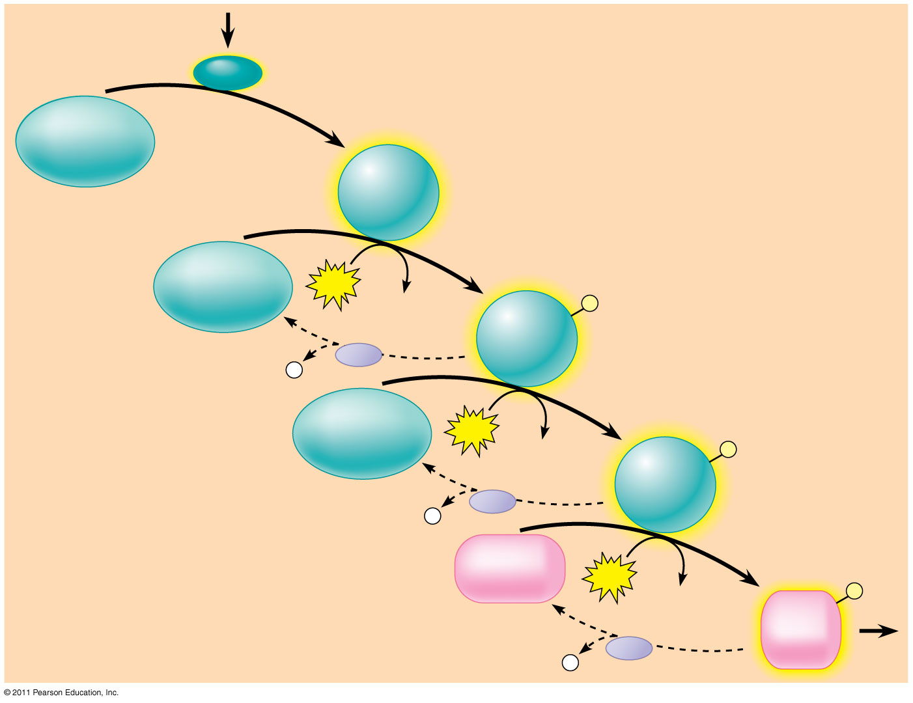
A phosphorylation cascade
Activated relay
molecule
Inactive
protein kinase
1
Active
protein
kinase
1
Inactive
protein kinase
2
Phosphorylation cascade
ATP
Active
protein
kinase
2
ADP
P
Inactive
protein kinase
3
ATP
Active
protein
kinase
3
ADP
P
Inactive
protein
ATP
ADP
Active
protein
P

Slide 31
Small Molecules and Ions as Second Messengers
The extracellular signal molecule (ligand) that binds to the receptor is a pathway’s “first messenger”
Second messengers are small, nonprotein, water-soluble molecules or ions that spread throughout a cell by diffusion
Second messengers participate in pathways initiated by GPCRs and RTKs
Cyclic AMP and calcium ions are common second messengers

Slide 32
Cyclic AMP
Cyclic AMP (cAMP) is one of the most widely used second messengers
Adenylyl cyclase, an enzyme in the plasma membrane, converts ATP to cAMP in response to an extracellular signal

Slide 33
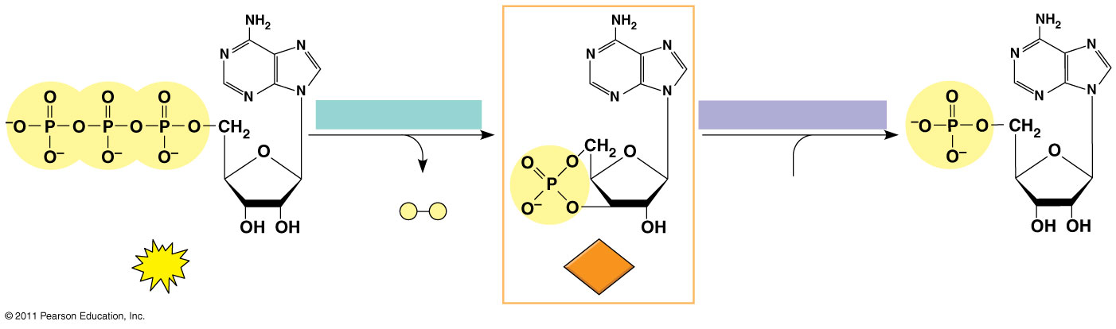
Cyclic AMP
Adenylyl cyclase
Phosphodiesterase
Pyrophosphate
H₂O
ATP
cAMP
AMP

Slide 34
Cyclic AMP
Many signal molecules trigger formation of cAMP
Other components of cAMP pathways are G proteins, G protein-coupled receptors, and protein kinases
cAMP usually activates protein kinase A, which phosphorylates various other proteins
Further regulation of cell metabolism is provided by G-protein systems that inhibit adenylyl cyclase

Slide 35
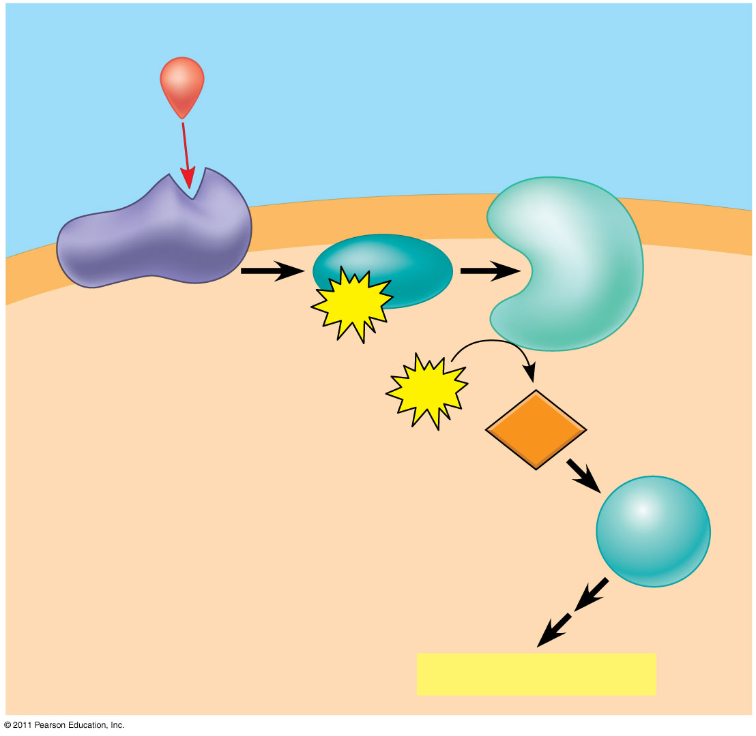
cAMP as a second messenger in a G protein signaling pathway
First messenger
(signaling molecule
such as epinephrine
Adenylyl
cyclase
G protein
G protein-coupled
receptor
GTP
ATP
Second
messenger
cAMP
Protein
kinase A
Cellular responses

Slide 36
Calcium Ions and Inositol Triphosphate (IP₃)
Calcium ions (Ca²⁺) act as a second messenger in many pathways
Calcium is an important second messenger because cells can regulate its concentration

Slide 37
Response: Cell signaling leads to regulation of transcription or cytoplasmic activities
The cell’s response to an extracellular signal is sometimes called the “output response”

Slide 38
Nuclear and Cytoplasmic Responses
Ultimately, a signal transduction pathway leads to regulation of one or more cellular activities
The response may occur in the cytoplasm or in the nucleus
Many signaling pathways regulate the synthesis of enzymes or other proteins, usually by turning genes on or off in the nucleus
The final activated molecule in the signaling pathway may function as a transcription factor

Slide 39
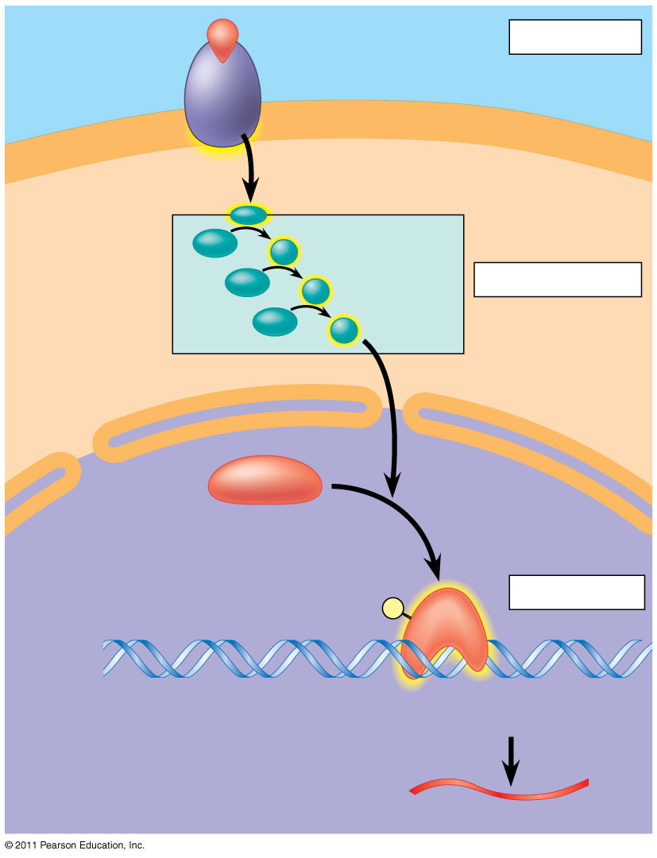
Nuclear responses to a signal: the activation of a specific gene by a growth factor
Growth factor
Reception
Receptor
Phosphorylation
cascade
Transduction
CYTOPLASM
Inactive
transcription
factor
Active
transcription
factor
Response
DNA
Gene
NUCLEUS
mRNA

Slide 40
Cell signaling
Signaling pathways can also affect the overall behavior of a cell, for example, changes in cell shape

Slide 41
Fine-Tuning of the Response
There are four aspects of fine-tuning to consider:
  Amplification of the signal (and thus the response)
  Specificity of the response
  Overall efficiency of response, enhanced by scaffolding proteins
  Termination of the signal

Slide 42
Signal Amplification
Enzyme cascades amplify the cell’s response
At each step, the number of activated products is much greater than in the preceding step

Slide 43
The Specificity of Cell Signaling and Coordination of the Response
Different kinds of cells have different collections of proteins
These different proteins allow cells to detect and respond to different signals
Even the same signal can have different effects in cells with different proteins and pathways
Pathway branching and “cross-talk” further help the cell coordinate incoming signals

Slide 44
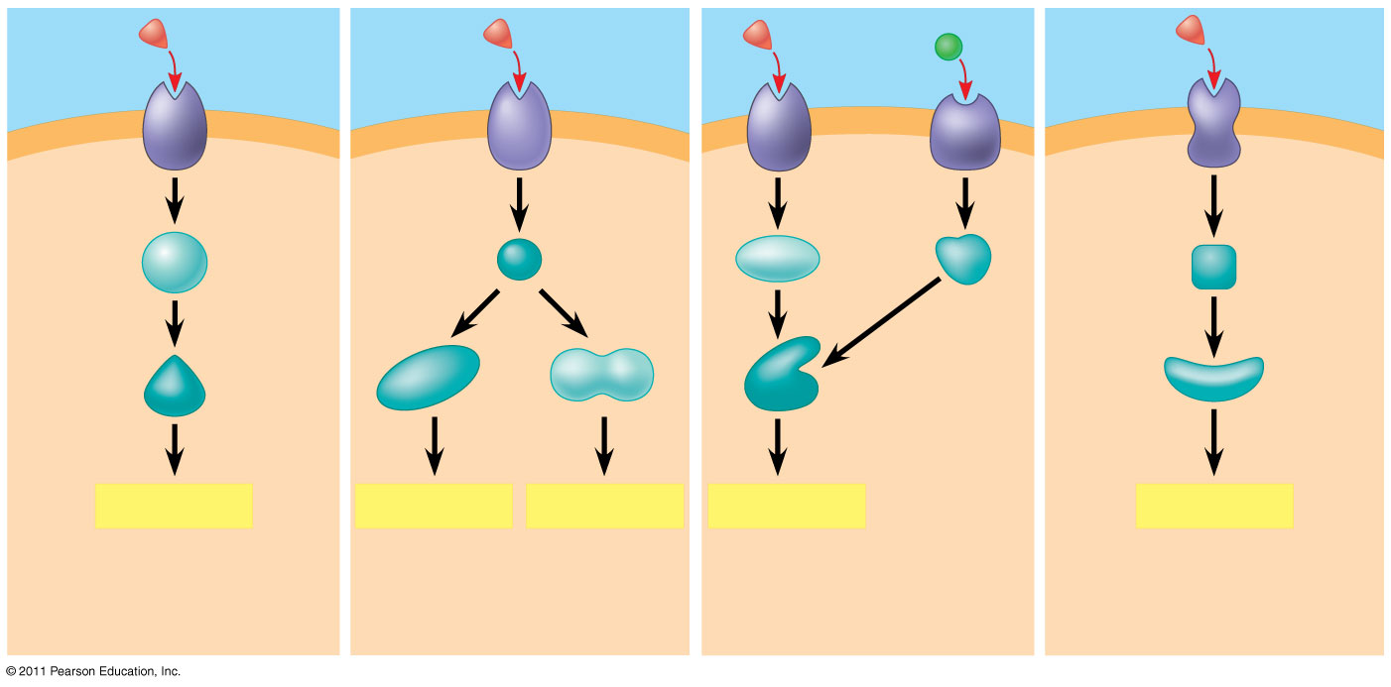
The specificity of cell signaling
Signaling
molecule
Receptor
Relay
molecules
Activation
or inhibition
Response 1
Response 2
Response 3
Response 4
Response 5
Cell D. Different receptor
leads to a different
response.
Cell A. Pathway leads
to a single response.
Cell B. Pathway branches
leading to two responses
Cell C. Cross-talk occurs
between two pathways.

Slide 45
Signaling Efficiency: Scaffolding Proteins and Signaling Complexes
Scaffolding proteins are large relay proteins to which other relay proteins are attached
Scaffolding proteins can increase the signal transduction efficiency by grouping together different proteins involved in the same pathway
In some cases, scaffolding proteins may also help activate some of the relay proteins

Slide 46
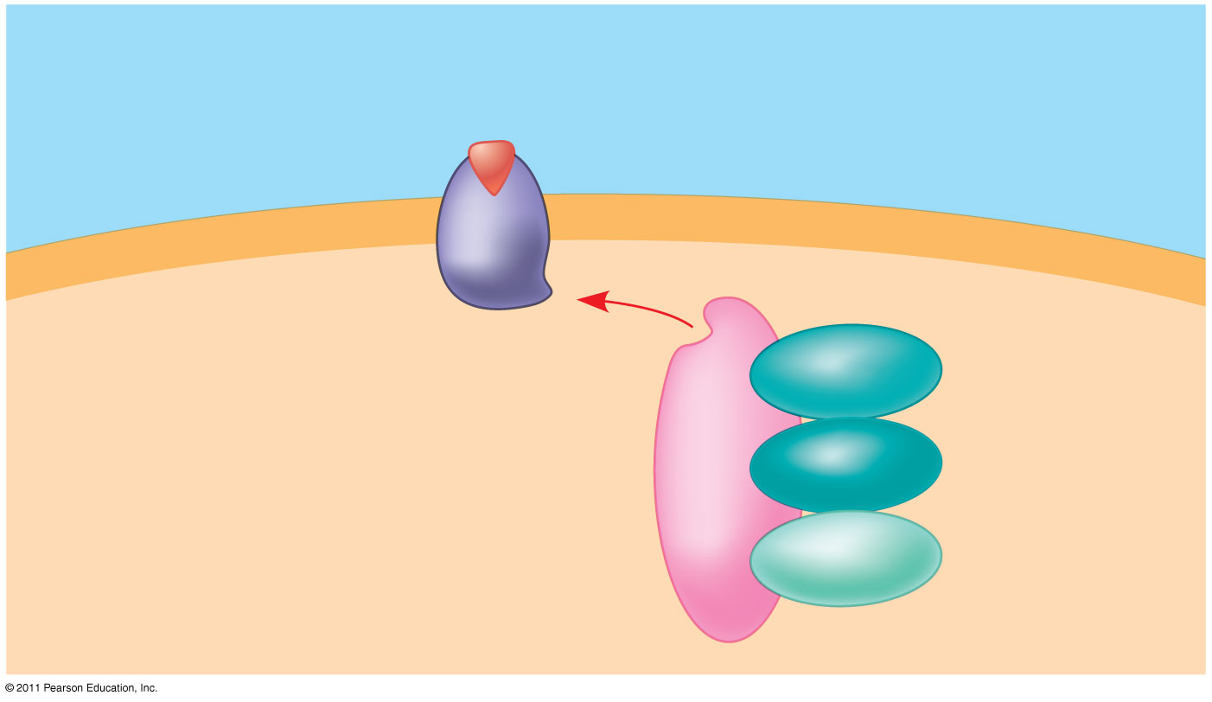
A scaffolding protein
Signaling
molecule
Plasma
membrane
Receptor
Three
different
protein
kinases
Scaffolding
protein

Slide 47
Termination of the Signal
Inactivation mechanisms are an essential aspect of cell signaling
If ligand concentration falls, fewer receptors will be bound
Unbound receptors revert to an inactive state

Slide 48
Apoptosis integrates multiple cell-signaling pathways
Apoptosis is programmed or controlled cell suicide
Components of the cell are chopped up and packaged into vesicles that are digested by scavenger cells
Apoptosis prevents enzymes from leaking out of a dying cell and damaging neighboring cells

Slide 49
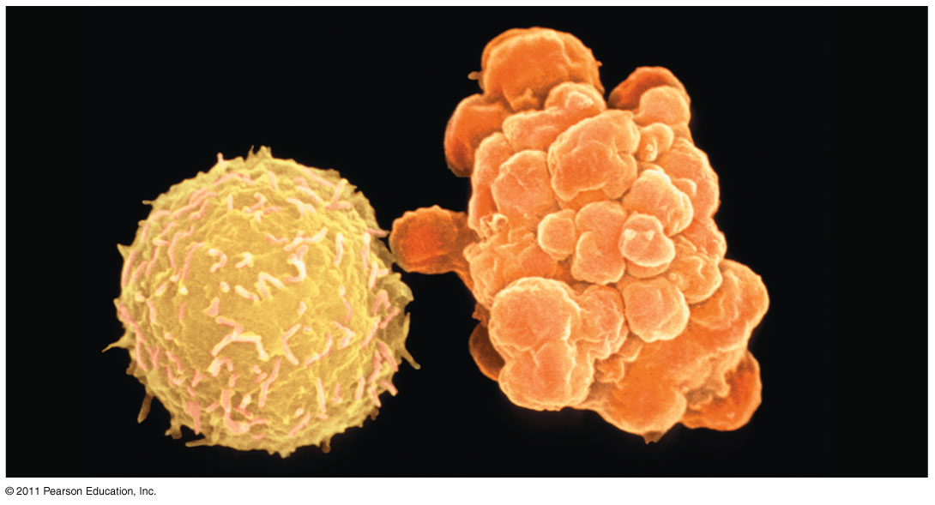
Apoptosis of a human white blood cell

Slide 50
Apoptotic Pathways and the Signals That Trigger Them
Caspases are the main proteases (enzymes that cut up proteins) that carry out apoptosis
Apoptosis can be triggered by:
  An extracellular death-signaling ligand
  DNA damage in the nucleus
  Protein misfolding in the endoplasmic reticulum

